Slide 1
Noise-Contrastive Estimation of Unnormalized Statistical Models
Yuding Liang
April 20,2016

Slide 2
Content
Problem to solve
Noise-Contrastive Estimation
Application to word embedding
Experimental evaluation of word embedding
Conclusion
Reference

Slide 3

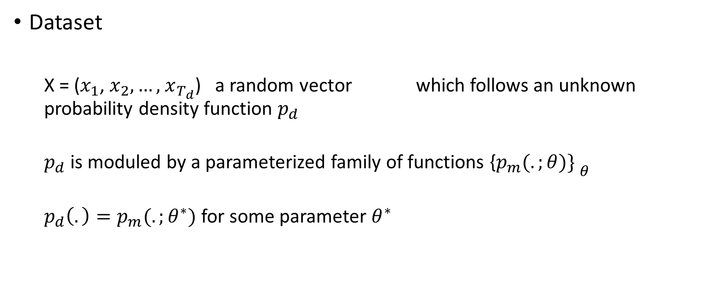
Problem to solve
Dataset
X = ($x_{1}$, $x_{2},…,$ $x_{T_{d}}$) a random vector which follows an unknown probability density function $p_{d}$
$p_{d}$ is moduled by a parameterized family of functions ${\text{\{}p_{m}(.;θ)\} }_{θ}$
$p_{d}\left(.\right)=p_{m}(.;θ^{∗})$ for some parameter $θ^{∗}$

Slide 4

Problem to solve
Two constraints
$$\int{p_{m}\left(u;θ\right)ⅆu}=1$$
$p_{m}\left(u;θ\right)≥0$
Normalized and unnormalized model
$p_{m}^{0}\left(.;α\right)$ : unnormalized model which is parameterized by some $α$

Slide 5

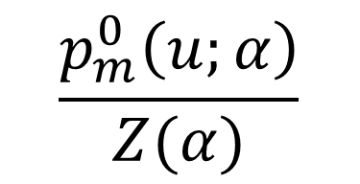
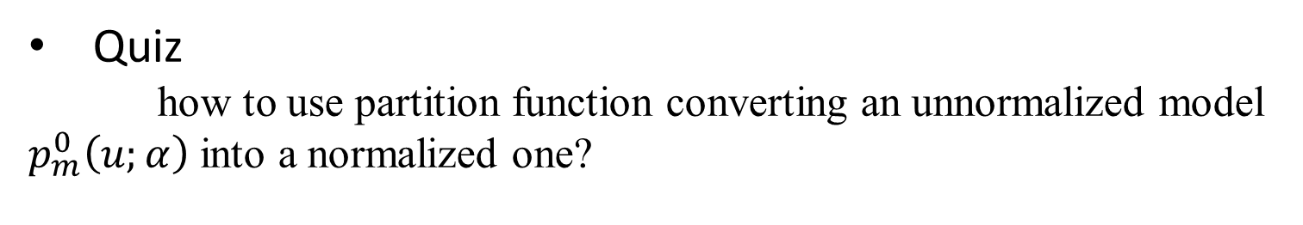
Problem to solve
Partition function
$$Z\left(α\right)=\int{p_{m}^{0}\left(u;α\right)ⅆu}$$
Quiz
how to use partition function converting an unnormalized model $p_{m}^{0}\left(u;α\right)$ into a normalized one?
$$\frac{p_{m}^{0}\left(u;α\right)}{Z(α)}$$

Slide 6
Problem to solve
Solutions for the estimation of unnormalized models
1. Monte Carlo maximum likelihood
2. contrastive divergence
3. score matching
Disadvantage
1. need to balance the accuracy of the estimate
2. need the time to compute the estimate

Slide 7
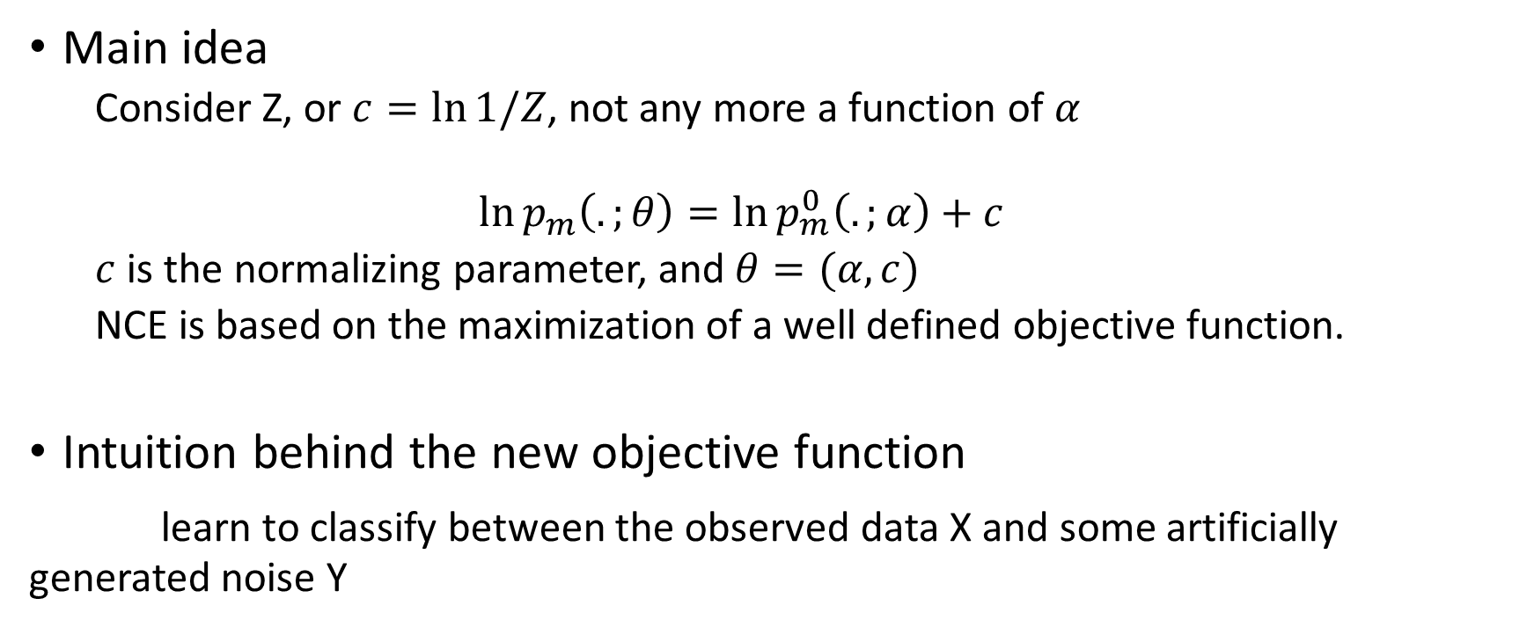
Noise-Contrastive Estimation
Main idea
Consider Z, or $c=\ln{1/Z}$, not any more a function of $α$
$$\ln{p_{m}\left(.;θ\right)}=\ln{p_{m}^{0}\left(.;α\right)}+c$$
$c$ is the normalizing parameter, and $θ=(α,c)$
NCE is based on the maximization of a well defined objective function.
Intuition behind the new objective function
learn to classify between the observed data X and some artificially generated noise Y

Slide 8
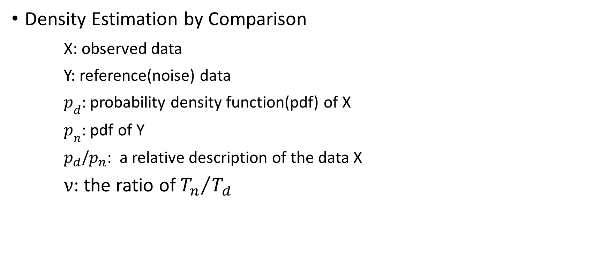
Noise-Contrastive Estimation
Density Estimation by Comparison
X: observed data
Y: reference(noise) data
$p_{d}$: probability density function(pdf) of X
$p_{n}$: pdf of Y
$p_{d}$/$p_{n}$: a relative description of the data X
$ν$: the ratio of ${T_{n}}/{T_{d}}$

Slide 9
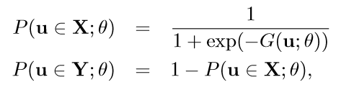

Noise-Contrastive Estimation
Logistic regression
Where

Slide 10
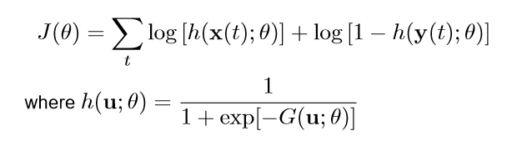

Noise-Contrastive Estimation
Conditional likelihood leads to the objective function
The estimator is deﬁned as

Slide 11
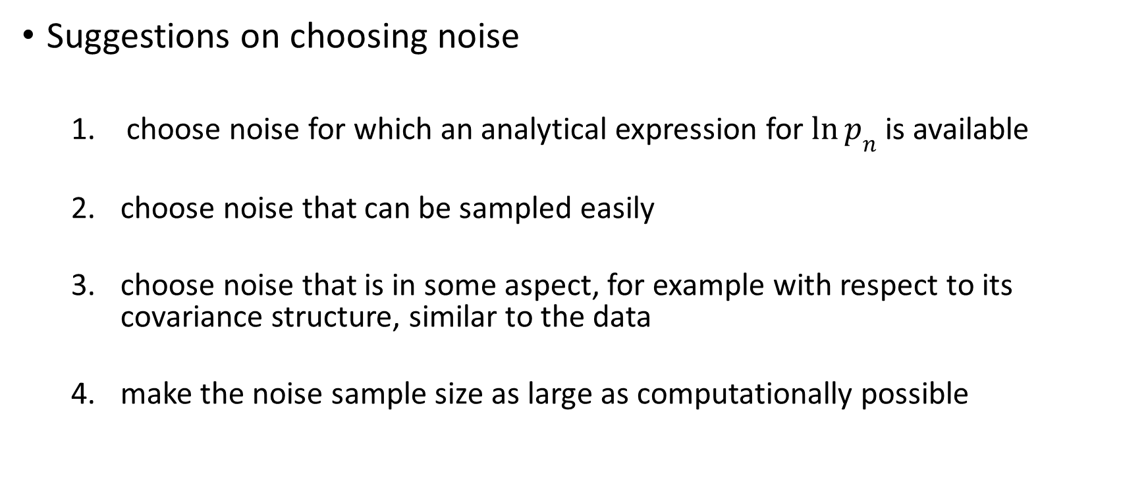
Noise-Contrastive Estimation
Suggestions on choosing noise
choose noise for which an analytical expression for $\ln{p_{n}}$ is available
choose noise that can be sampled easily
choose noise that is in some aspect, for example with respect to its covariance structure, similar to the data
make the noise sample size as large as computationally possible

Slide 12
Application to word embedding
Learning flexible word representations is the first step towards learning semantics.
The best current approach to learning word embedding involves training a neural language model to predict each word in a sentence from its neighbours.
– Need to use a lot of data and high-dimensional embedding to achieve competitive performance.
– More scalable methods translate to better results.
propose a simple and scalable approach to learning word embedding based on training lightweight models with noise-contrastive estimation.
– It is simpler, faster, and produces better results than the current state-of-the art method.

Slide 13
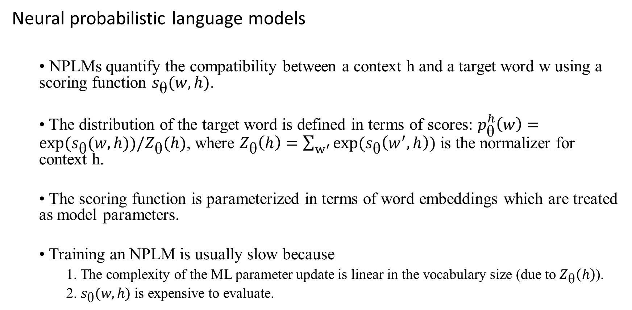
Application to word embedding
Neural probabilistic language models
• NPLMs quantify the compatibility between a context h and a target word w using a scoring function $s_{\text{θ}}(w,h)$.
• The distribution of the target word is defined in terms of scores: $p_{\text{θ}}^{h}\left(w\right)=\exp{{(s}_{\text{θ}}(w,h))/Z_{\text{θ}}(h)}$, where $Z_{\text{θ}}\left(h\right)=\sum_{w^{′}}{exp⁡(s_{\text{θ}}\left(w^{′},h\right))}$ is the normalizer for context h.
• The scoring function is parameterized in terms of word embeddings which are treated as model parameters.
• Training an NPLM is usually slow because
1. The complexity of the ML parameter update is linear in the vocabulary size (due to $Z_{\text{θ}}\left(h\right)$).
2. $s_{\text{θ}}(w,h)$ is expensive to evaluate.

Slide 14
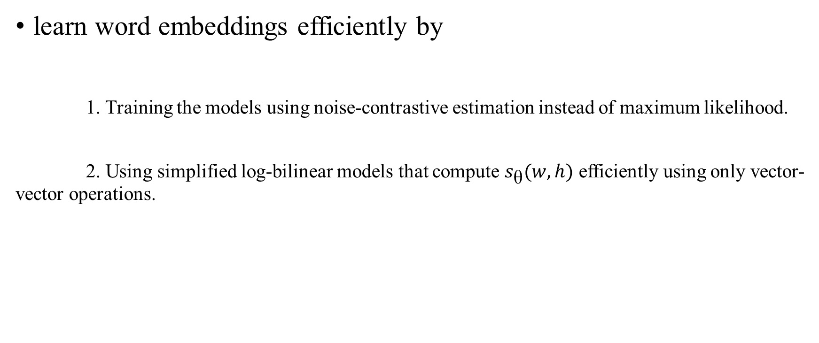
Application to word embedding
learn word embeddings efficiently by
1. Training the models using noise-contrastive estimation instead of maximum likelihood.
2. Using simplified log-bilinear models that compute $s_{\text{θ}}(w,h)$ efficiently using only vector-vector operations.

Slide 15
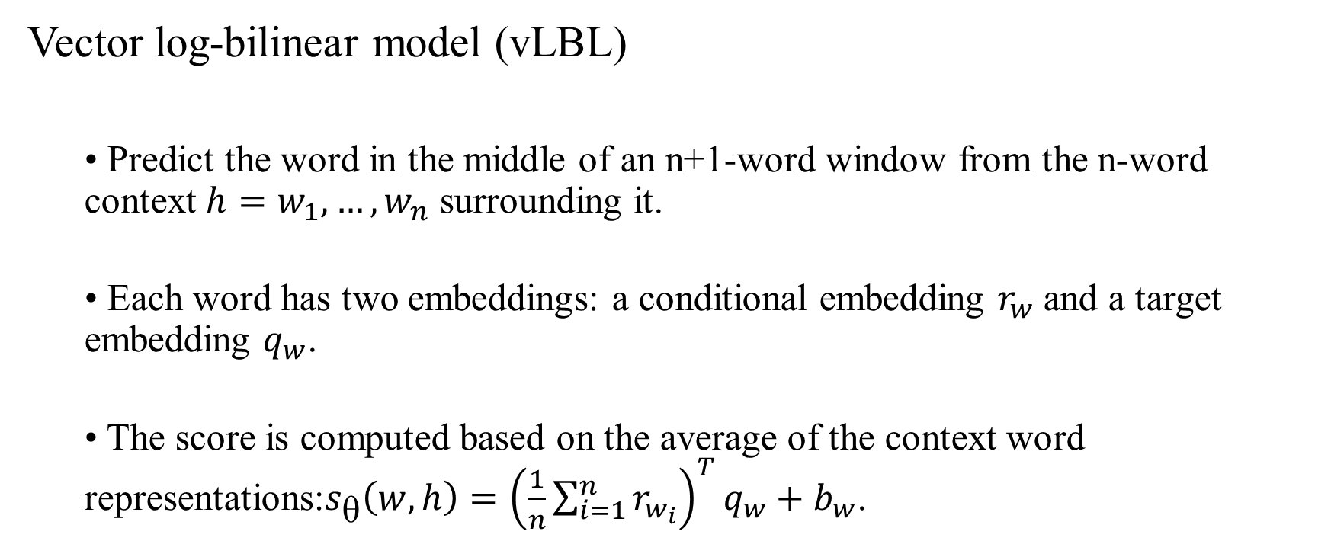
Application to word embedding
Vector log-bilinear model (vLBL)
• Predict the word in the middle of an n+1-word window from the n-word context $h=w_{1},…,w_{n}$ surrounding it.
• Each word has two embeddings: a conditional embedding $r_{w}$ and a target embedding $q_{w}$.
• The score is computed based on the average of the context word representations:$s_{\text{θ}}\left(w,h\right)={\left(\frac{1}{n}\sum_{i=1}^{n}{r_{w_{i}}}\right)}^{T}q_{w}+b_{w}$.

Slide 16
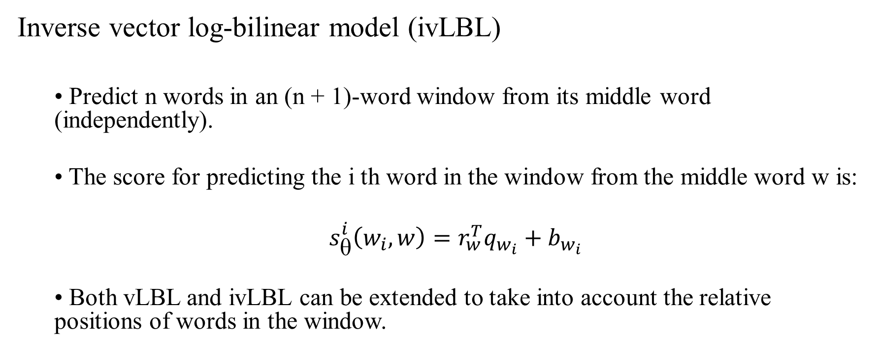
Application to word embedding
Inverse vector log-bilinear model (ivLBL)
• Predict n words in an (n + 1)-word window from its middle word (independently).
• The score for predicting the i th word in the window from the middle word w is:
$s_{\text{θ}}^{i}\left(w_{i},w\right)=r_{w}^{T}q_{w_{i}}+b_{w_{i}}$
• Both vLBL and ivLBL can be extended to take into account the relative positions of words in the window.

Slide 17
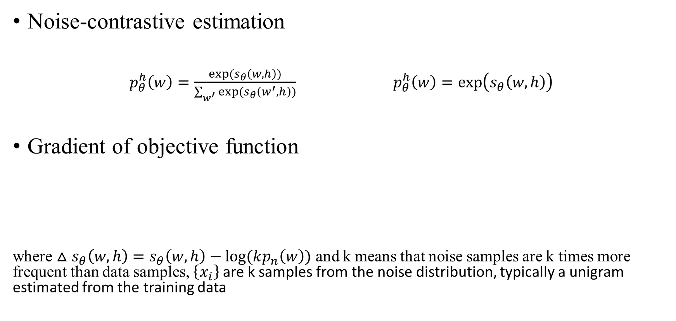
Application to word embedding
Noise-contrastive estimation
$p_{θ}^{h}\left(w\right)=\frac{exp⁡(s_{θ}\left(w,h\right))}{\sum_{w^{′}}{exp⁡(s_{θ}\left(w^{′},h\right))}}$ $p_{θ}^{h}\left(w\right)=\exp\left(s_{θ}\left(w,h\right)\right)$
Gradient of objective function
where $△s_{θ}\left(w,h\right)=s_{θ}\left(w,h\right)−log⁡(kp_{n}\left(w\right))$ and k means that noise samples are k times more frequent than data samples, $\left\{x_{i}\right\}$ are k samples from the noise distribution, typically a unigram estimated from the training data

Slide 18
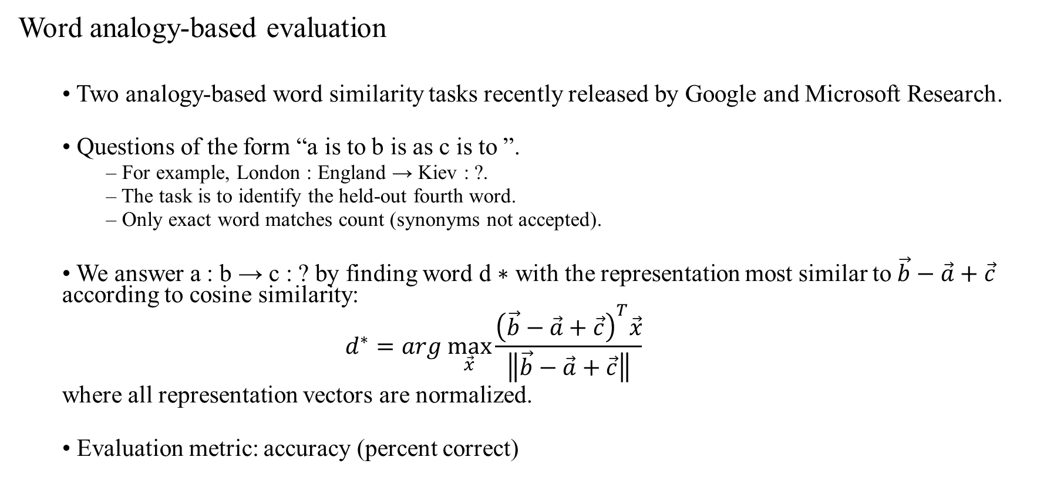
Experimental evaluation of word embedding
Word analogy-based evaluation
• Two analogy-based word similarity tasks recently released by Google and Microsoft Research.
• Questions of the form “a is to b is as c is to ”.
– For example, London : England → Kiev : ?.
– The task is to identify the held-out fourth word.
– Only exact word matches count (synonyms not accepted).
• We answer a : b → c : ? by finding word d ∗ with the representation most similar to $\vec{b}−\vec{a}+\vec{c}$ according to cosine similarity:
$$d^{∗}=arg \max_{\vec{x}}{\frac{{\left(\vec{b}−\vec{a}+\vec{c}\right)}^{T}\vec{x}}{\left\|\vec{b}−\vec{a}+\vec{c}\right\|}}$$
where all representation vectors are normalized.
• Evaluation metric: accuracy (percent correct)

Slide 19
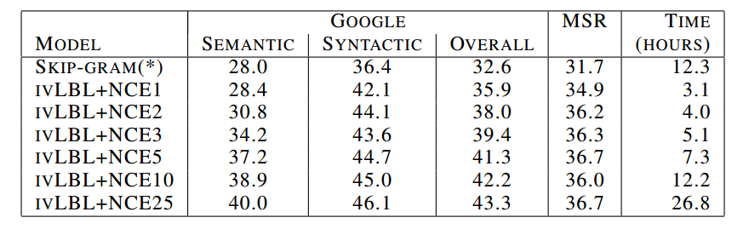
Experimental evaluation of word embedding
NCE vs. tree-based training
• Training data: Wikipedia from April 2013 – 1.5B words, 870K-word vocabulary
• Experimental setup (unless stated otherwise):
– Models: 100D word embeddings, predict 5 words on both sides, no position-dependent weights.
– NCEk denotes NCE training using k noise samples.

Slide 20
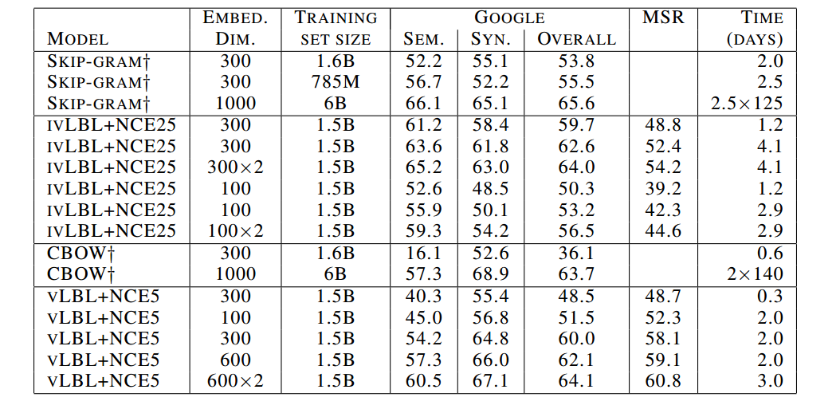
Experimental evaluation of word embedding
Large-scale evaluation

Slide 21
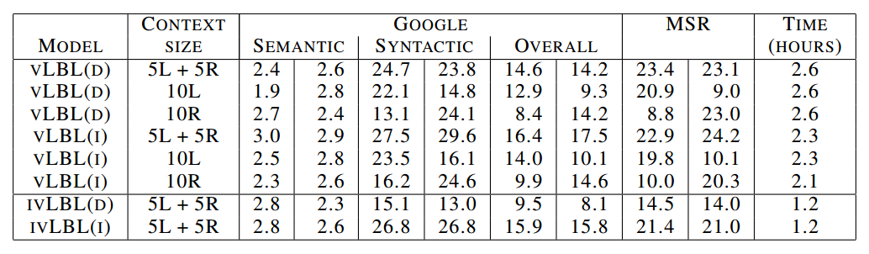
Experimental evaluation of word embedding
How do more expressive models perform?
• We can make our models more expressive by making them aware of word order through position-dependent weights. Does this lead to better word embeddings?
• Dataset: MSR Gutenberg corpus – 47M words, 80K-word vocabulary
• Left/right column gives the in-vocabulary accuracy obtained using the conditional/target word embeddings.

Slide 22
Experimental evaluation of word embedding
MSR Sentence Completion Challenge
Task: given a sentence with a missing word, pick the correct completion from a list of candidate words.
• Training set: 522 19th-century novels (47M words)
• Test set: 1,040 sentences from five Sherlock Holmes novels
• Five candidate completions per sentence.
MODEL | CONTEXT SIZE | LATENT DIM | PERCENT CORRECT
LSA | SENTENCE | 300 | 49
SKIP-GRAM | 10L+10R | 640 | 48.0
LBL | 10L | 300 | 54.7
ivLBL | 5L+5R | 100 | 51.0
ivLBL | 5L+5R | 300 | 55.2
ivLBL | 5L+5R | 600 | 55.5

Slide 23
Conclusion
Unnormalized statistical models for which the normalizing partition function cannot be computed in closed form, and such models can’t be estimated by maximization of the likelihood without resorting to numerical approximations.
NCE can estimate unnormalized statistical models without normalizing partition function

Slide 24
Reference
Mnih A, Kavukcuoglu K. Learning word embeddings efficiently with noise-contrastive estimation[C]//Advances in Neural Information Processing Systems. 2013: 2265-2273.
Gutmann M U, Hyvärinen A. Noise-contrastive estimation of unnormalized statistical models, with applications to natural image statistics[J]. The Journal of Machine Learning Research, 2012, 13(1): 307-361.

Slide 25
Thanks

